Slide 1
Classes 1 and 2: Computer tools to assist your work in structural biology
Computer graphics
Structural bioinformatics
The physics and chemistry of biology
Molecular modeling
Molecular simulations
Understanding experiments
Knowing the biology

Slide 2
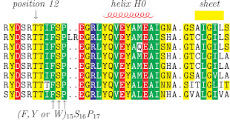
Analysis of sequences and alignments
Annotations specific for the sequence and for families (UniProt, PFAM)
Disorder prediction & predictions on IDRs
Bibliography (PubMed, Alerts, text mining, large language models)
Known domains:
BlastPDB, PFAM, UniProt, Hhpred, SwissModel, AF-EBI
Conservation vs. variability (k*=1-20)
Linear properties like secondary structure propensity, solvent exposure, hydrophobicity, TM helices, beta barrels
All kinds of specific predictions such as signal peptides and other localization signals, MORFs, etc. etc.

Slide 3
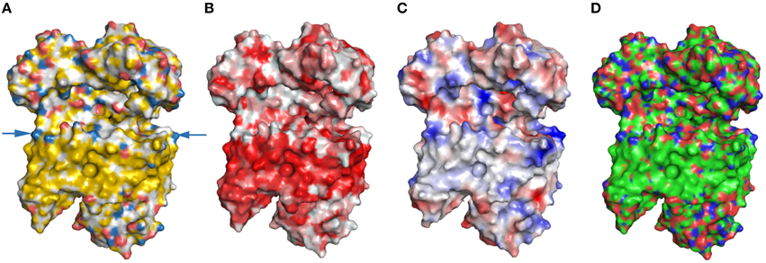
Analysis of 3D models (wherever they come from)
Visualization
(PyMOL, VMD, Chimera(X), JSmol, Coot, … AR/VR)
Mapping information and predictions (literature, your own data, NMR or MS mapping, conservation, properties, etc.). Use B-factors for residue-wise data, lines or contact maps for residue-residue data
Annotations for sequence and family (UniProt, PFAM)
Model dynamics from quantum to classical atomistic to classical big chunks
Detect motifs and domains, for ex. With DALI or FoldSeek
Surface properties like electrostatics (see PDB2PQR and APBS websites)
Define soluble vs. (trans)membrane regions
Modeling homologous proteins
Analyze primary data (B-factors, electronic densities, NOEs, chemical shifts…)
Compare structures: PyMol et al ok for very similar sequences, otherwise use a sequence-independent program like https://zhanglab.ccmb.med.umich.edu/TM-align/
Ex. https://www.frontiersin.org/articles/10.3389/fmolb.2015.00056/full

Slide 4
PART 1: Where to obtain 3D models in the first place?
Speaking I tend to call “structures” the purely experimentally derived models, and I tend to use “models” for the rest
In written form I call them all models, not structures, because everything is a model (of reality)… Even “Structures” are models of atoms distributed in a way that explains the experimental data obtained under some specific conditions
X-ray/neutron diffraction, NMR, cryoEM, etc.: wwPDB and associated databases
Integrative models: PDB-Dev, SASBDB, etc.
Purely computational models: Model Archive, AF-EBI database, SI materials, ModelSearch
Online or local molecular modeling tools like CHARMM-GUI and others we’ll see later on

Slide 5
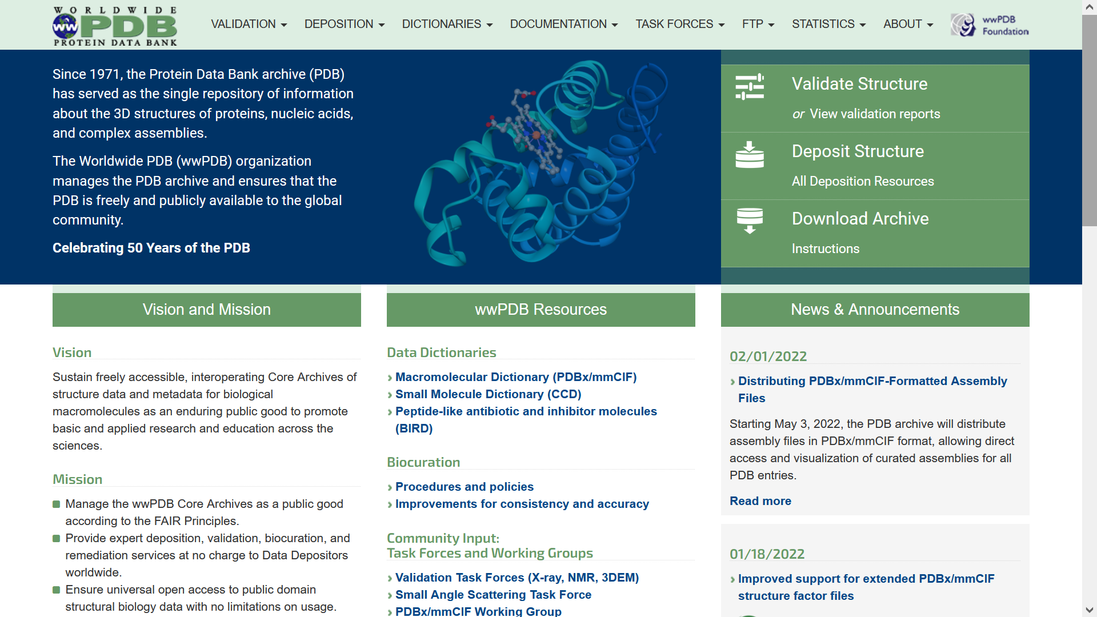
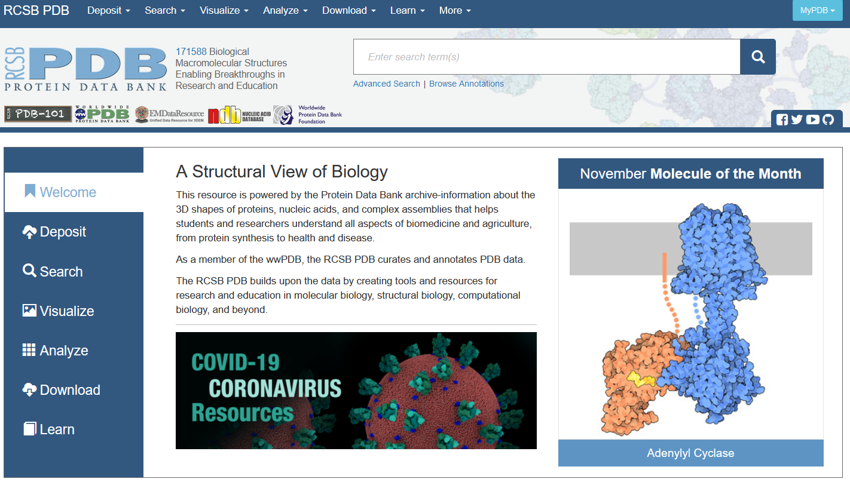
The main structural database: the world-wide Protein Data Bank

Slide 6
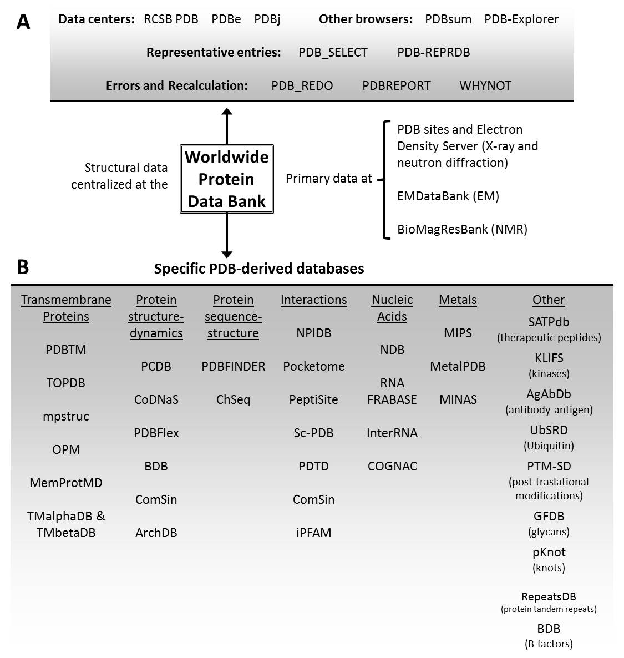
The wwPDB and its associated databases
Clickable version at:
http://lucianoabriata.altervista.org/papersdata/bib2016.html
Abriata LA Briefings in Bioinformatics 2016

Slide 7
LA: Show RCSB PDB LA: Show some PDB-related sites from http://lucianoabriata.altervista.org/papersdata/bib2016.html LA: Show a piece of PDB code
Show on browser…

Slide 8
A database specific for Integrative Structural Biology ISB: 3D models (sometimes static, sometimes ensembles) built by putting together different pieces of data often obtained from different techniques of different resolution. Example: an accurate X-ray or NMR structure for one domain + a possible model for another, both connected by a flexible linker that is just modeled as a polymer, and the overall shape of the whole thing is restrained by SAXS data. Challenge: how to assess, display, store and distribute such models?

Slide 9
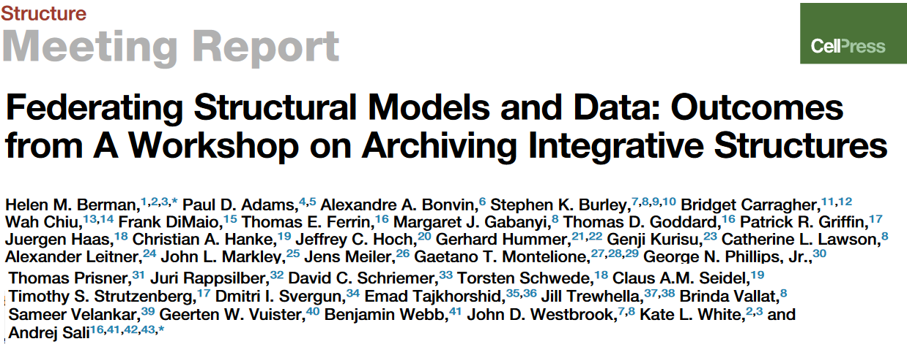
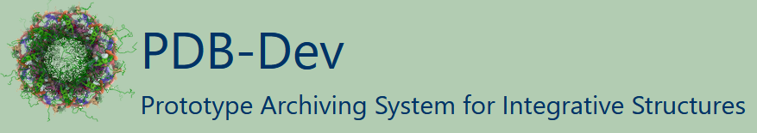
PDB-Dev
- Berman HM et al., Structure. 2019 Dec 3; 27(12): 1745-1759. doi:10.1016/j.str.2019.11.002
- Vallat B et al., J Biomol NMR. 2019 Jul; 73(6-7): 385-398. doi:10.1007/s10858-019-00264-2
- Vallat B et al., Structure. 2018 Jun; 26(6):894-904. doi:10.1016/j.str.2018.03.011
- Burley SK et al., Structure. 2017 Sep; 25(9):1317-1318. doi: 10.1016/j.str.2017.08.001
- Sali A et al., Structure. 2015 Jul; 23(7):1156-1167. doi: 10.1016/j.str.2015.05.013
Other important databases
- Yorodumi: PDB+EMDB+SASBDB browser at https://pdbj.org/emnavi/quick.php
- SASBDB: Repository of SAXS data and models, also from atomistic to blobs
Some programs and servers
- HADDOCK – Originally for docking, now includes more data
- Integrative Modeling Platform: https://www.ncbi.nlm.nih.gov/pmc/articles/PMC3260315/
- Programs specific for EM, SAXS, etc

Slide 10
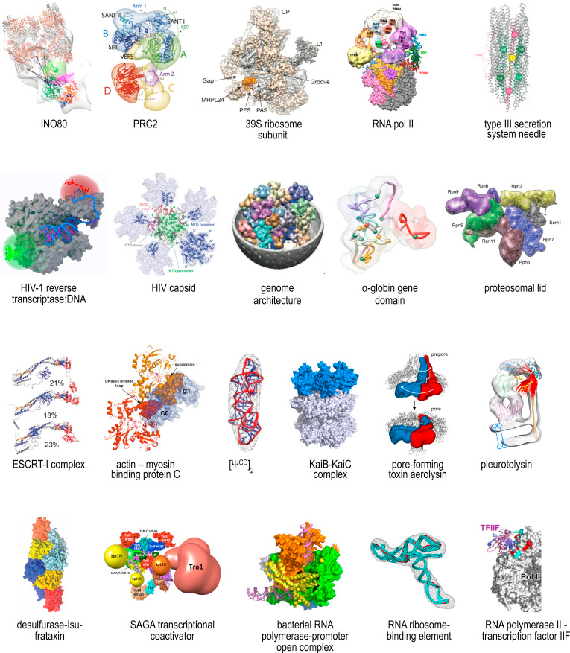
Different regions solved at different resolutions
MULTISCALE MODELING
Need for special representations
Uncertainties vs. dynamics
Conformations and states?

Slide 11
PART 1: Where to obtain 3D models in the first place?
Speaking I tend to call “structures” the purely experimentally derived models, and I tend to use “models” for the rest
In written form I call them all models, not structures, because everything is a model (of reality)… Even “Structures” are models of atoms distributed in a way that explains the experimental data obtained under some specific conditions
X-ray/neutron diffraction, NMR, cryoEM, etc.: wwPDB and associated databases
Integrative models: PDB-Dev, SASBDB, etc.
Purely computational models: Model Archive, AF-EBI database, SI materials, ModelSearch… we’ll see next class
Online or local molecular modeling tools like CHARMM-GUI and others we’ll see next class

Slide 12
One last tool: modelsearch
Contact-based models
DMPfold, Pcons, Tara3D, Gremlin
MA, PMP, PMDB
CASP models
Paper SIs
etc…
SASBDB
PDB-Dev
>your_protein
PRTEINSEQENCE
http://labriataphd.altervista.org/
→ Follow modelsearch link
Models
http://labriataphd.altervista.org/
Abriata et al Bioinformatics 2020

Slide 13
PART 2: Molecular graphics
Key at any stage of structural biology
Only a quick revision of the history of molecular graphics & tools
We’ll see just a few key programs, but there are more
A personal outlook into the future

Slide 14
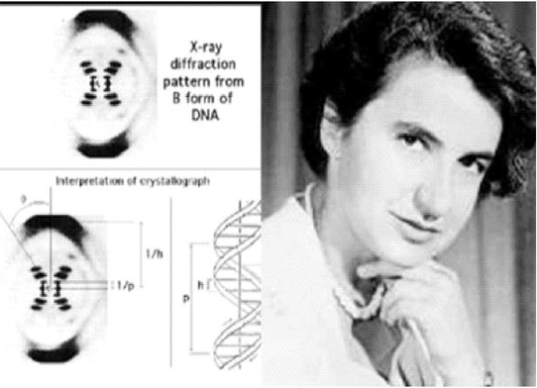
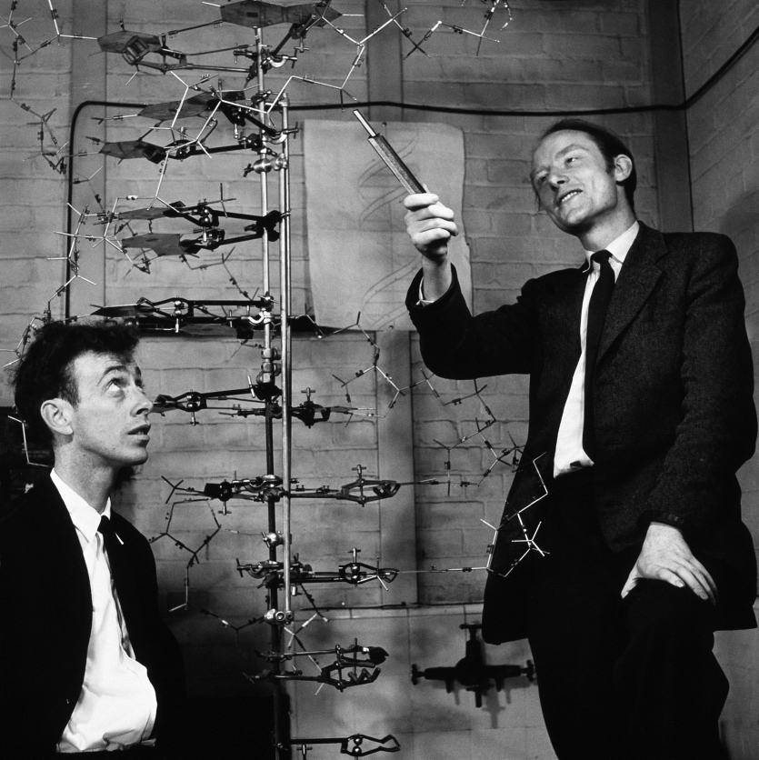
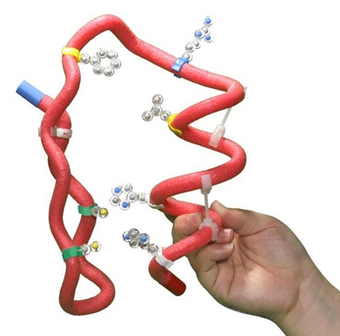
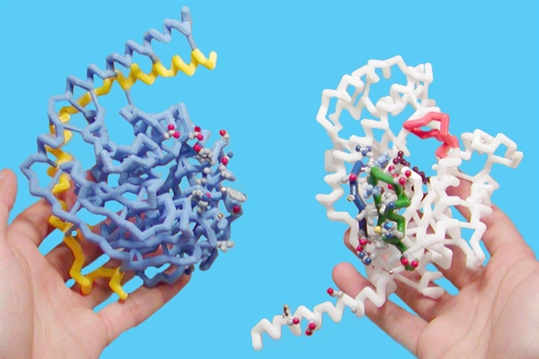
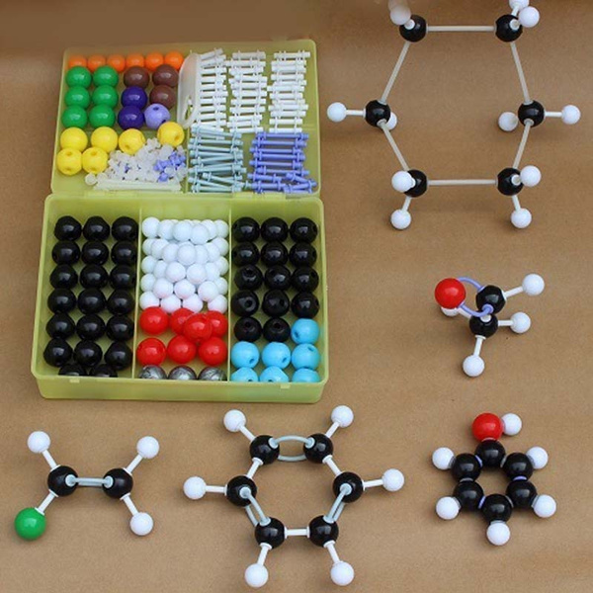
Tangible models

Slide 15
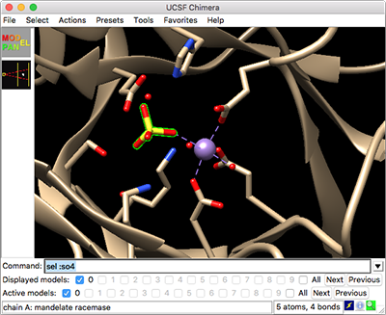
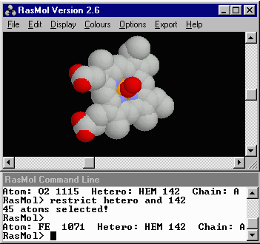
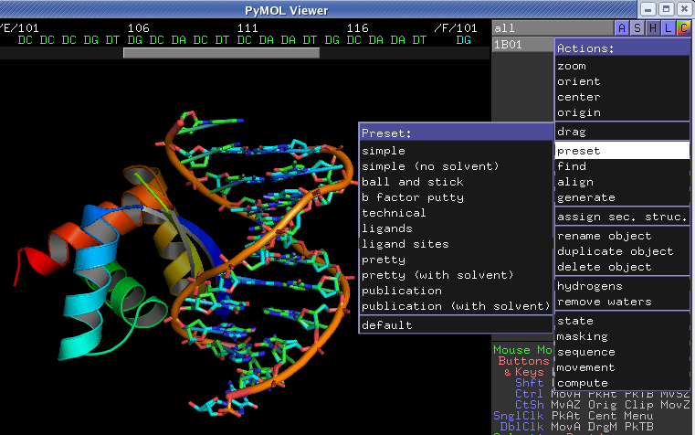
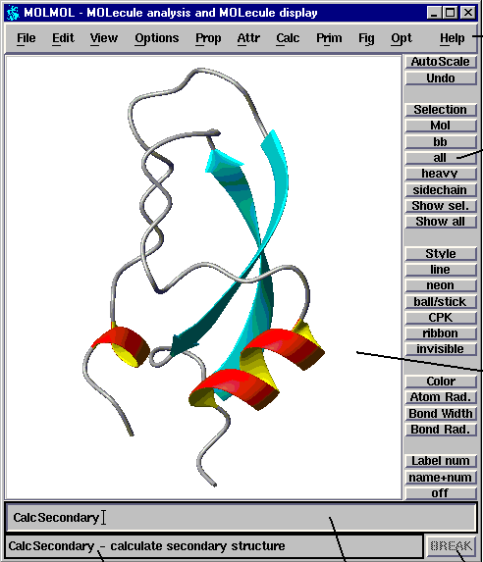
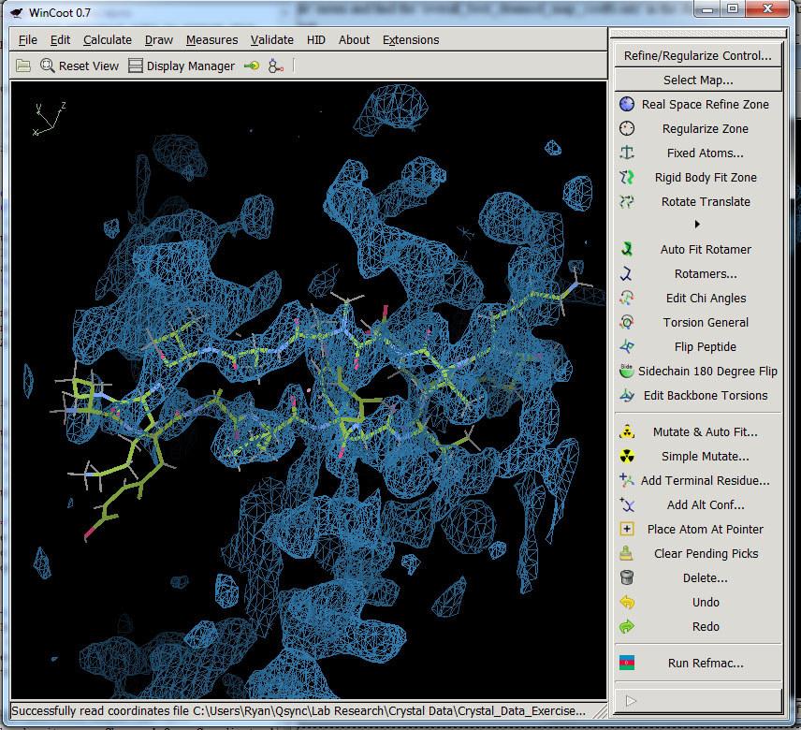
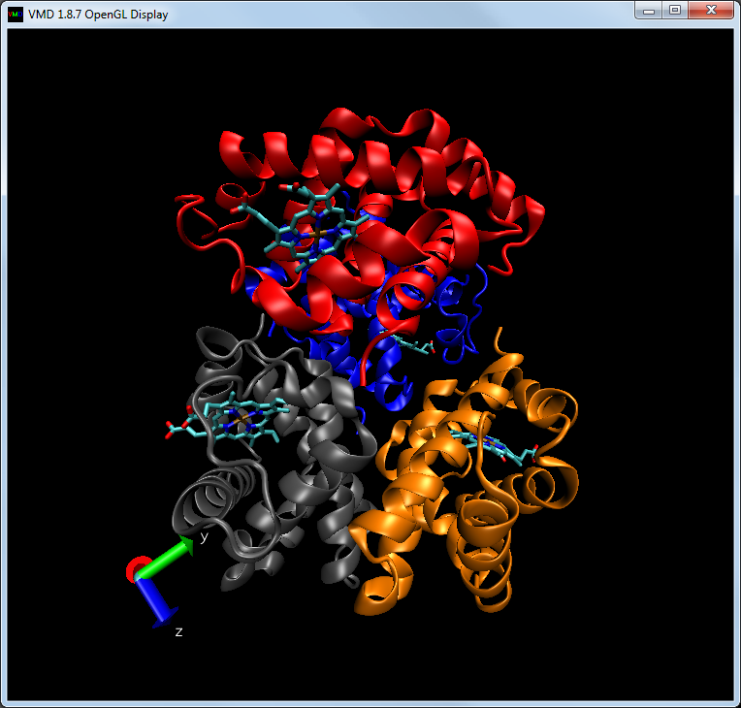

Computer graphics offer information-rich views, at the expense of control

Slide 16
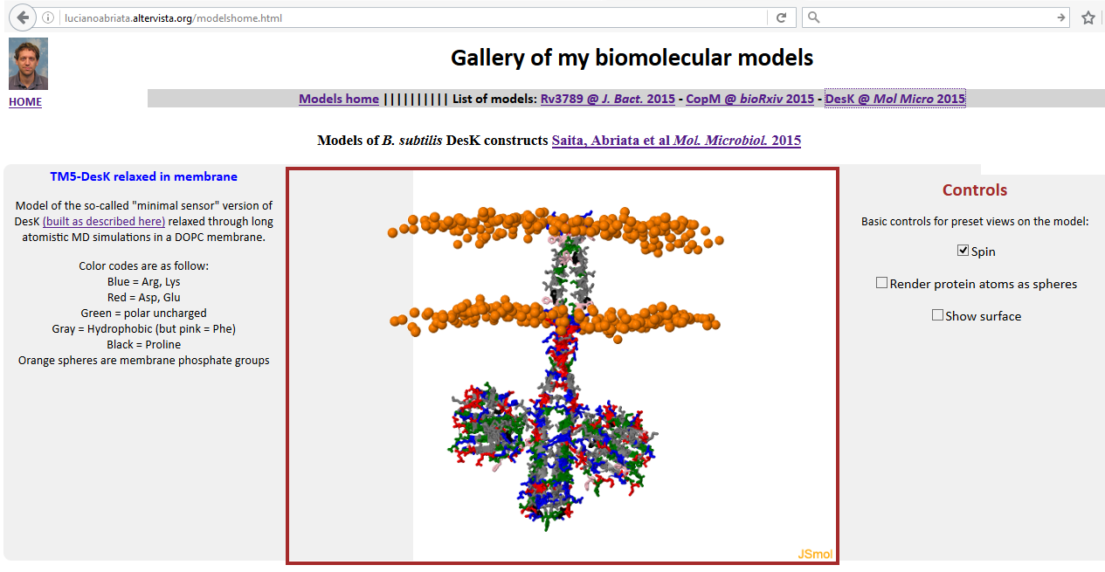
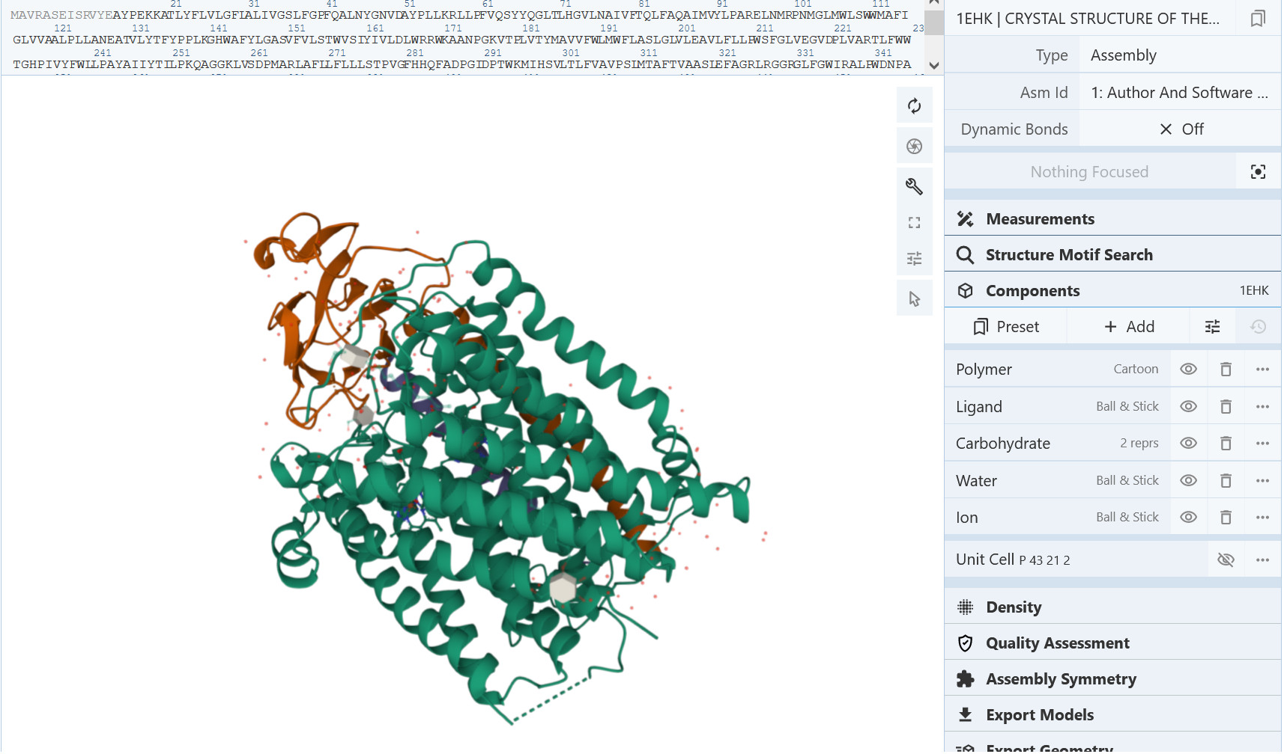
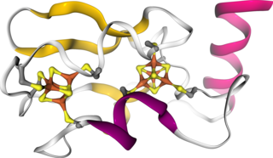
HTML-embeddable molecular graphics
JSmol
- Can load ready-made pymol sessions (example)
- Can display more than molecules (maps, orbitals from Gaussian, etc. etc.)
- Very good cross-device support
- Scriptable to provide interactivity
- Linkable to other libraries (examples on eye-gazing, concurrent collaboration)
- Can couple multiple views (example)
Mol*
Brings data by pieces -esp. useful for exploring large maps
NGL

Slide 17





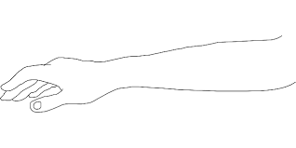

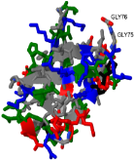

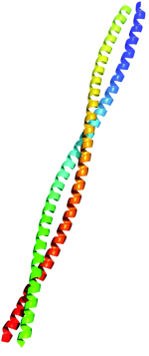

Back to the future / “tangible computer graphics”
High-Performance Computing
Molecular Mechanics
Bioinformatics
…
Concurrent Interactive
Collaboration
Energy:
van der Waals
Electrostatic
Mutation
I45F
[Link]
Databases
Webservices
…

Slide 18
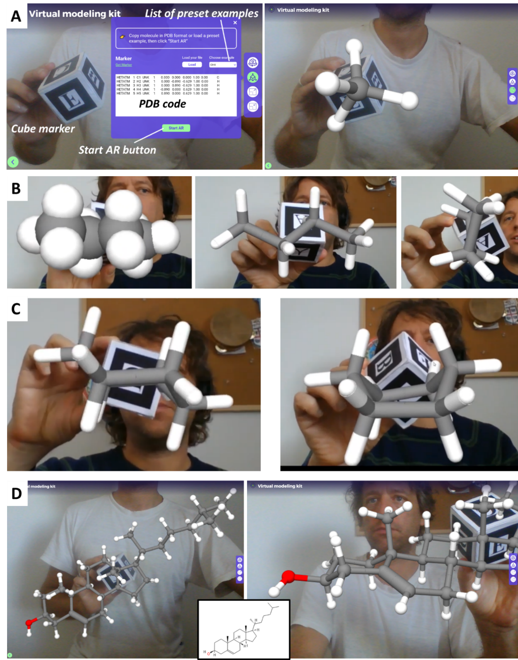
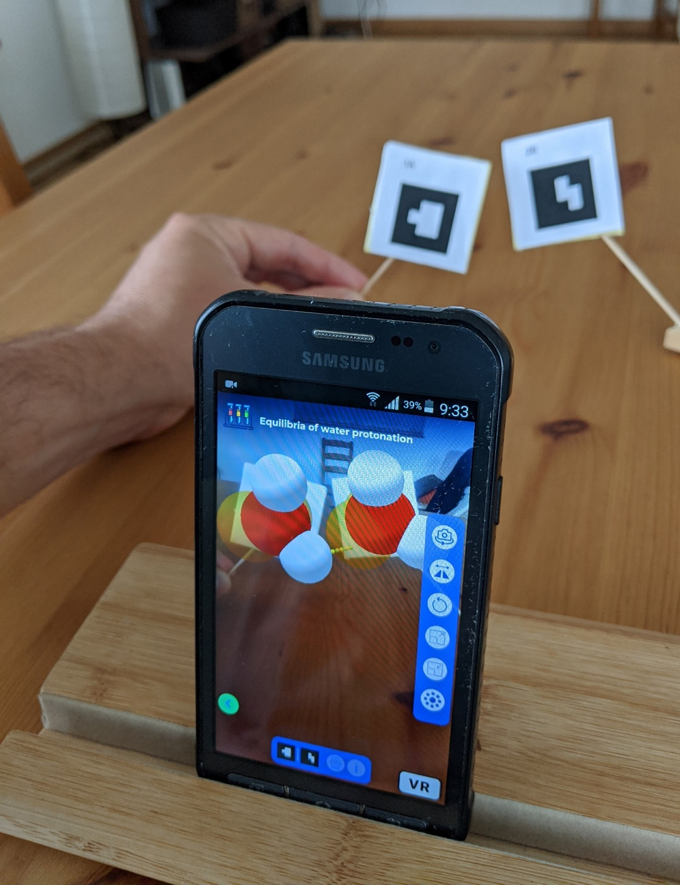
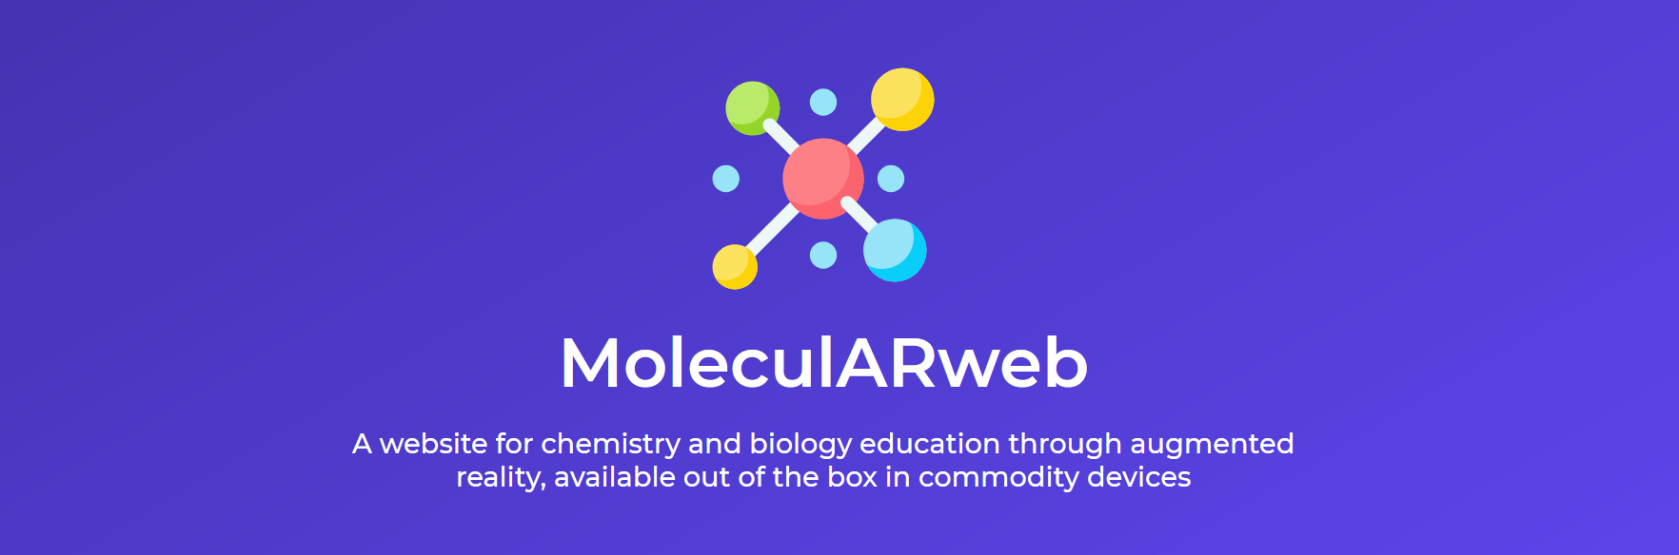
http://labriataphd.altervista.org/
Cortes et al J Chem Educ 2021

Slide 19
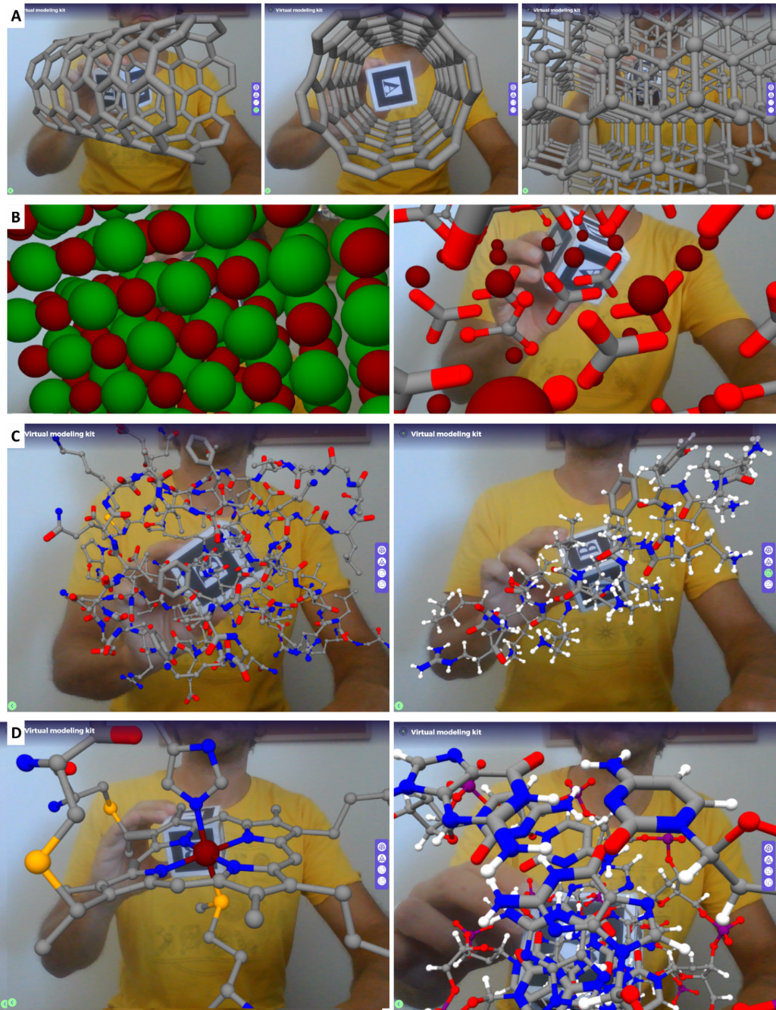
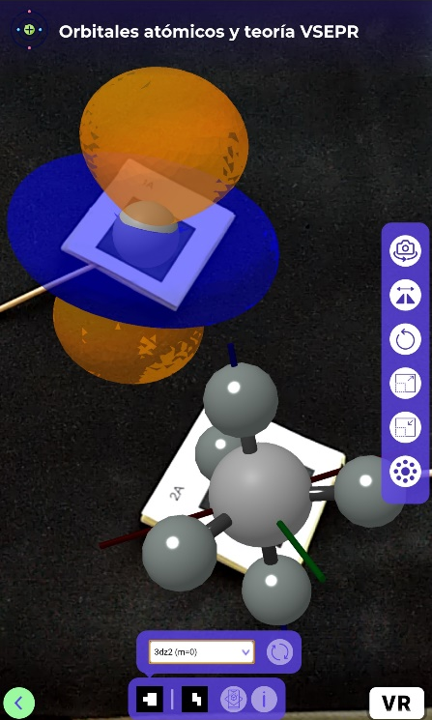
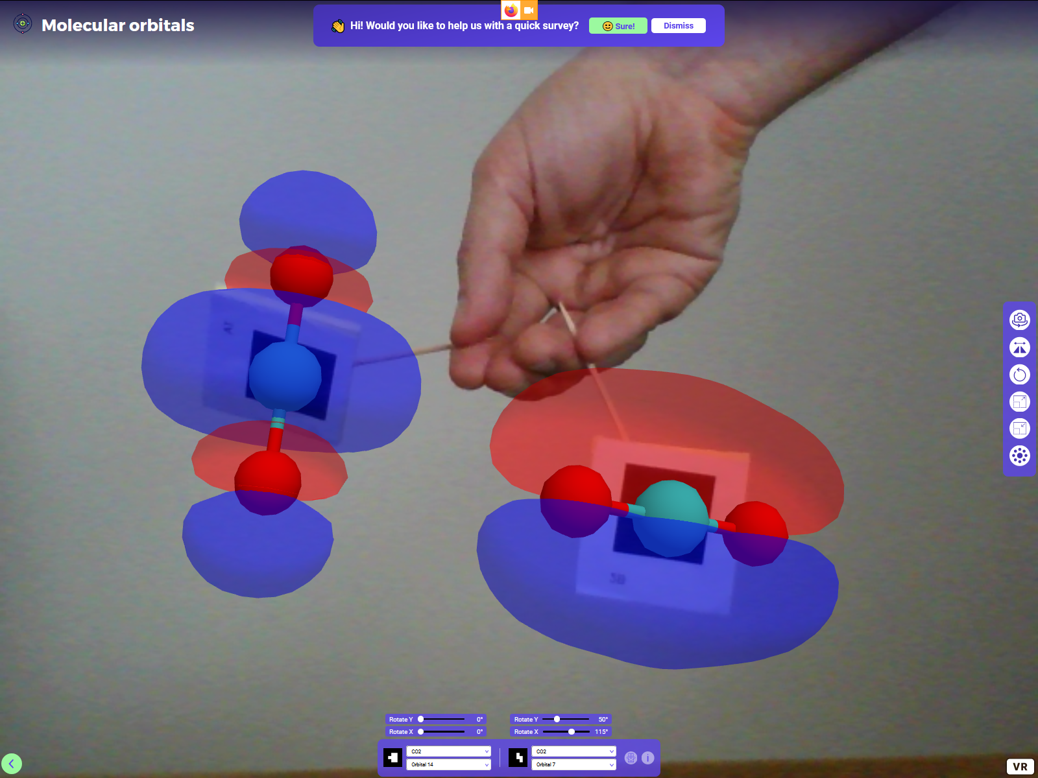
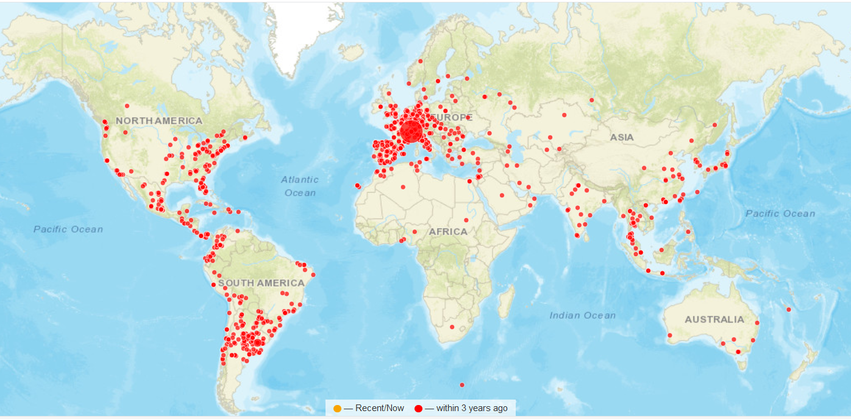
https://clustrmaps.com/site/1ar2f
Cortes et al J Chem Ed 2020

Slide 20
From PDB to AR and deep VR in few steps,
without installing anything, right on the web
https://molecularweb.epfl.ch/pages/pdb2ar.html

Slide 21
LA: Show PyMOL basics KL: Show ChimeraX basics Students: * Visit a PDB site or one of its related sites * Get to a PDB entry and try to find its source data and the related paper/s. (Alternatively, begin by a paper and go look for the relevant PDB entries). * View the model on your computer. What program is best, esp. considering the data? * Are all structural details well supported by the data? Does it matter for this or that application? (More to be developed throughout the course)
Hands-on

